Slide 1
Parking Lot Counts

Slide 2
Purpose of Parking Counts
The purpose of these recent parking counts is to better understand the parking utilization across the 4 main City owned parking lots.
Durkee Street Parking Lot
Broad Street Parking Lot
Court Street Parking Lot
City Hall Place Parking Lot

Slide 3
Carl Walker Parking Study
Peak Occupancy of City Lots
85% - Noon (Not Including Bridge St. Lot)
55% - Evenings
Margaret and Court – 100%
Durkee St. – 86%
Can Usually Find A Space in Durkee St. Lot
http://www.cityofplattsburgh.com/586/Downtown-Parking

Slide 4
Recent Parking Lot Counts
Weekday Counts have been between April 22nd – May 10th
So far 46 Weekday Parking Lot Counts
Weekday Morning Counts | Weekday Afternoon Counts
6:00 – 6:30 am: 5 Counts | 12:00 – 12:30 pm: 5 Counts
8:00 – 8:30 am: 4 Counts | 1:00 – 1:30 pm: 4 Counts
10:00 – 10:30 am: 7 Counts | 2:00 – 2:30 pm: 10 Counts
 | 3:00 – 3:30 pm: 1 Counts
 | 4:00 – 4:30 pm: 5 Counts
 | 6:00 – 6:30 pm: 4 Counts
 | 7:00 – 7:30 pm: 1 Count

Slide 5
Lowest and Highest Measured Utilization
Parking Lot | Lowest Measured Utilization | Highest Measured Utilization
Durkee Street | 20% (6:00 – 6:30 am) | 86% (2:00 – 2:30 pm)
Broad Street | 5% (6:00 – 6:30 am) | 108% (6:00 – 6:30 pm)
Court Street | 14% (6:00 – 6:30 am) | 91% (6:00 – 6:30 pm)
City Hall Place | 18% (6:00 – 6:30 am) | 100% (6:00 – 6:30 pm)

Slide 6
Average City Parking Lot Usage Per Hour

Slide 7
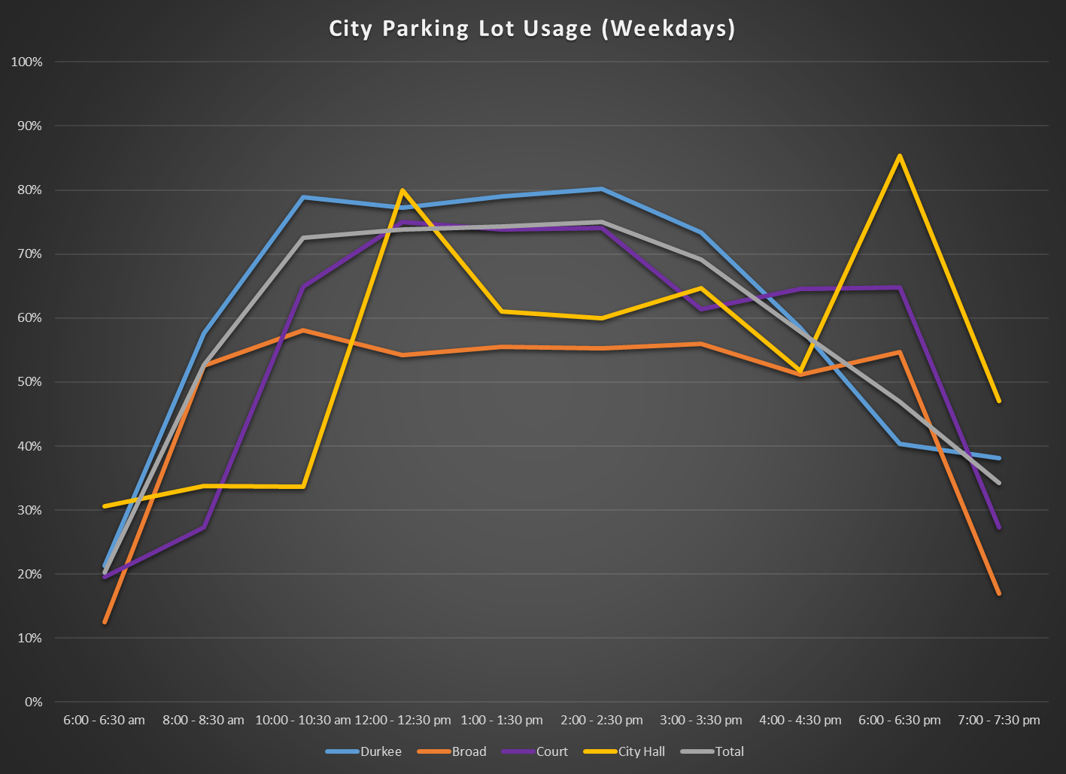

Slide 9
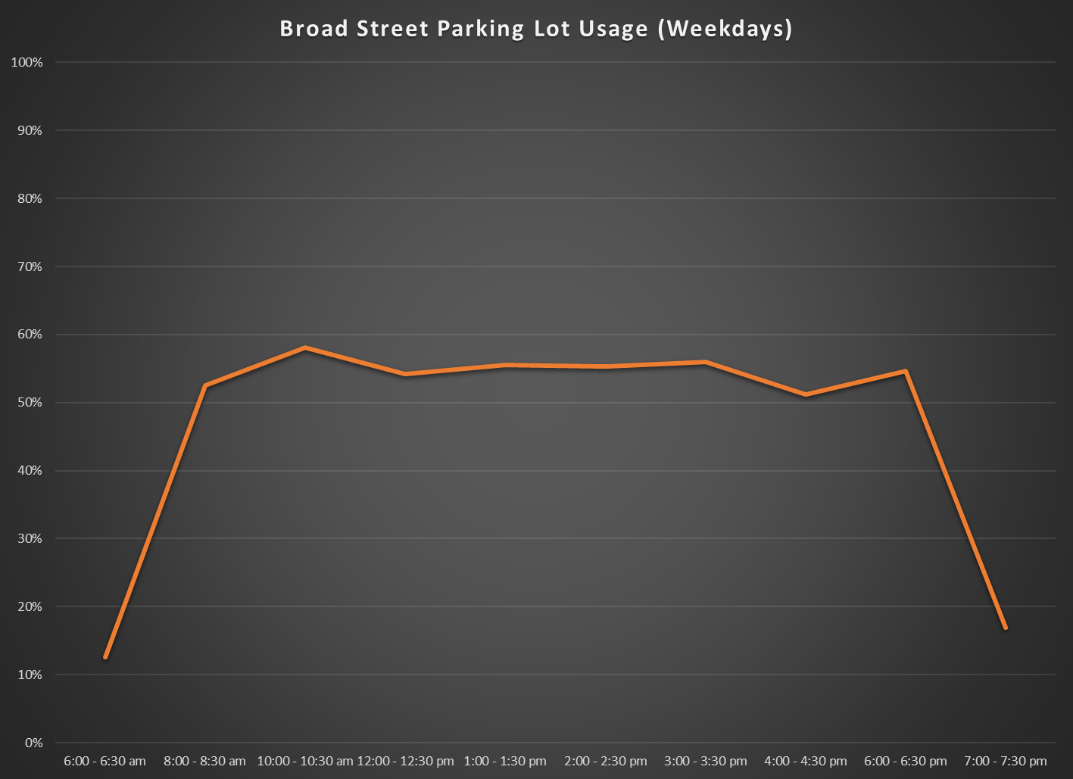

Slide 10
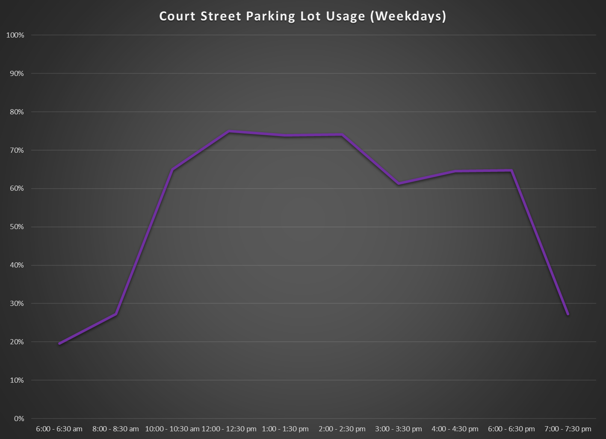

Slide 11
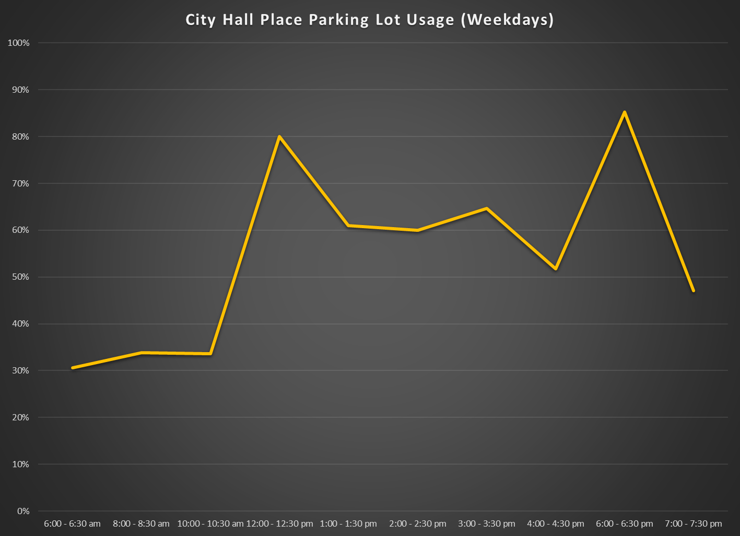

Slide 12
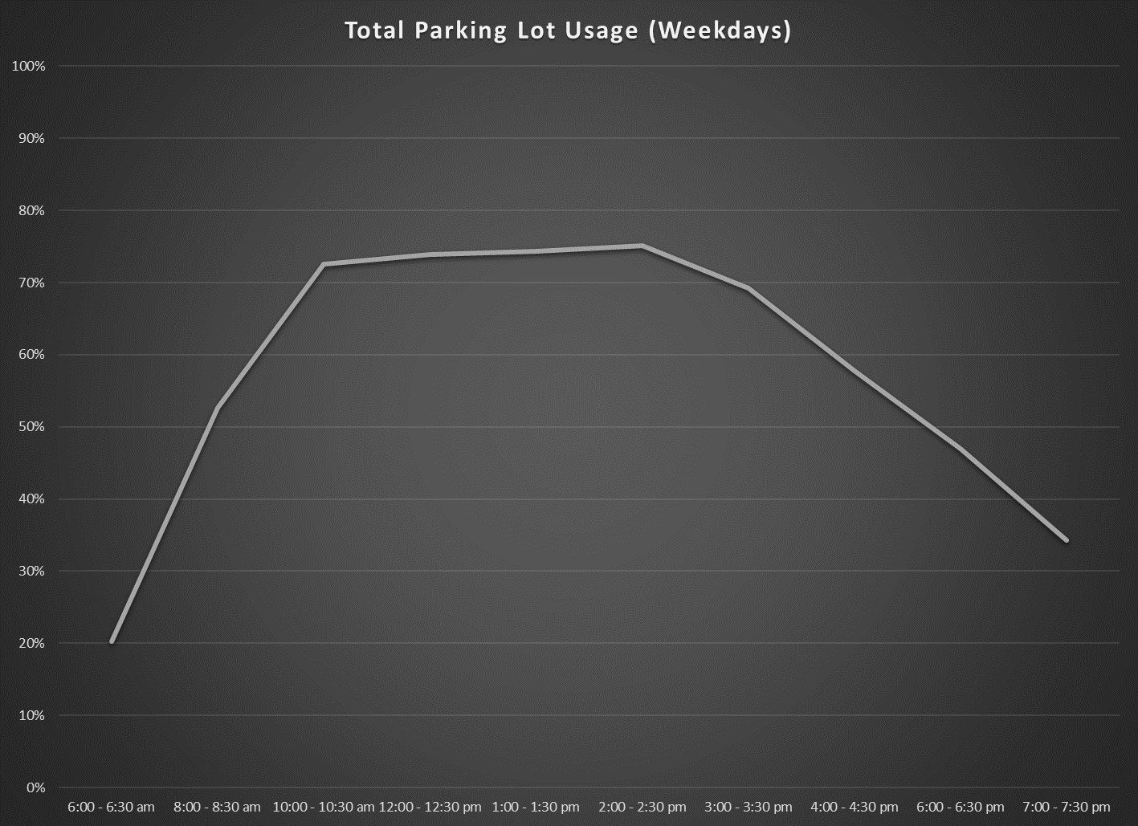

Slide 13
Next Steps
Continue Parking Lot Counts during the Weekdays
Increase Evening Parking Counts
Increase Weekend Parking Counts
Work on a system for On-Street parking counts

